Slide 1


BIKE SALES ANALYSIS DASHBOARD-INSIGHTS & FINDINGS
Using Excel
Prepared by : Rajat Potgantiwar

Slide 2

EXECUTIVE SUMMARY
Built an interactive Excel dashboard with slicers, KPIs, and dynamic charts
Analyzed customer demographics, behavior, and regional performance
Identified key buying patterns and conversion trends
Extracted insights to support data-driven business decisions.

Slide 3
BUSINESS PROBLEM
Identify which customers buy bikes.
Understand influence of gender, age, income, and region.
Analyze external factors like commute distance, marital status, children.
Understand customer conversion rate.
Help leadership with quick real-time insights.

Slide 4
METHODOLOGY
Data Cleaning
Data Processing
Data Analysis
Data Visualization

Slide 5

KPI CARDS OVERVIEW
Total Customers: 1026
Total Buyers: 495
Conversion Rate: 48%
Gender Split: Male 51%, Female 49%

Slide 6




BUYER VS NON-BUYER ANALYSIS
Using Donut Chart
Buyers: 48%
Non-Buyers: 52%

Slide 7
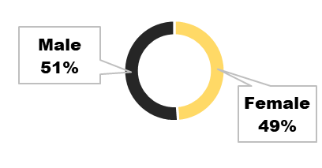
MALE VS FEMALE BUYERS
Using Donut Chart
Male buyers: 51%
Female buyers: 49%
Hence, Gender split is almost equal.

Slide 8
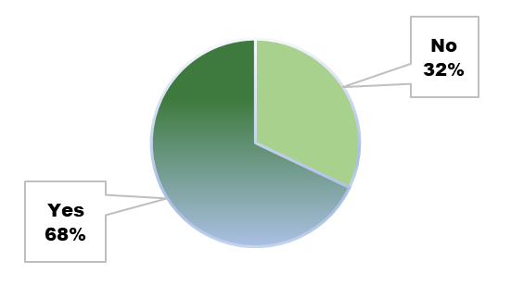
HOME OWNERSHIP VS PURCHASE
Using Pie Chart
Homeowners buying: 68%
Renters buying: 32%
Hence, Homeowners have more financial stability.

Slide 9
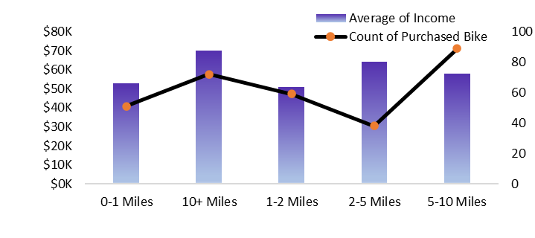
COMMUTE DISTANCE VS INCOME VS PURCHASE
Using Combo Chart
Highest buyers are 0–1 miles commuters(in case of adult). and 5-10 miles (in case of seniors).
Lowest bike purchase among 10+ miles commuters(in case of adult) and 2-5 miles(in case of senior).

Slide 10
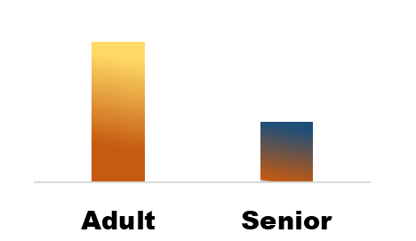
AGE GROUP VS BUYERS
Using Column Chart
Adults (20–50) are the major buyers
Seniors purchase significantly less.

Slide 11
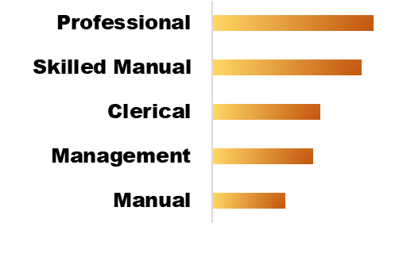
OCCUPATION VS BUYERS
Using Bar Chart
Top buyers: Skilled Manual & Professional
Lowest buyers: Manual labor
Hence, it Indicates bike purchases are linked to income stability

Slide 12
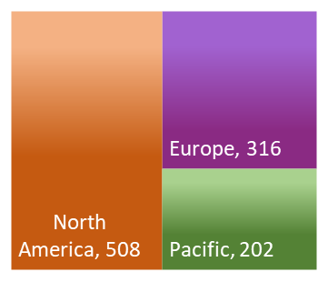
BUYERS ACROSS REGIONS
Using Tree map
North America (508) → highest buyers
Europe (316) → second
Pacific (202) → lowest
Hence, Region heavily influences purchase behavior.

Slide 13

TOP 5 HIGH IMPACT FILTERS
influencing Bike Purchase
Commute Distance
-Short-distance commuters are most likely to buy.
Age Group
-Adults dominate purchases.
Region
-North America & Europe drive the majority of sales.
Income
-Higher income → higher purchase probability.
Home Ownership
-Homeowners show strong purchase inclination (68%)

Slide 14


OVERALL INSIGHTS
for Stakeholders
Adults are the key target group
Gender split is balanced → both segments equally important
Homeowners & high-income professionals are dominant buyers
North America & Europe outperform Pacific region

Slide 15
BUSINESS RECOMMENDATIONS
Focus marketing on Adults aged 20–50.
Promote high-utility commute-friendly bikes .
Increase presence in North America & Europe, boost Pacific with offers.
Create occupation-based financing plans.
Launch female-oriented campaigns.
Offer premium models or loans to high-income & homeowners.
Use demographic filters (cars, marital status, children) for micro-targeting.
.

Slide 16

THANK YOU!!

